Slide 1
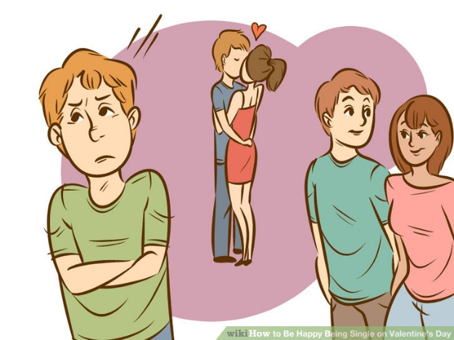
30-50% of the people you know are single!

Slide 2
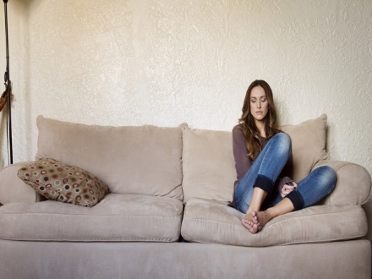
Is being single a sin? a curse? a blessing?
image from olwomen.com

Slide 3
Deuteronomy 7.14 NIV: You will be blessed more than any other people; none of your men or women will be childless, nor will any of your livestock be without young.
Proverbs 18.22 NIV: He who finds a wife finds what is good and receives favor from the LORD.
image from goodfon.su

Slide 4
Mosaic Covenant
For Israel
Before the cross
New Covenant
For Israel & Church
After the cross

Slide 5
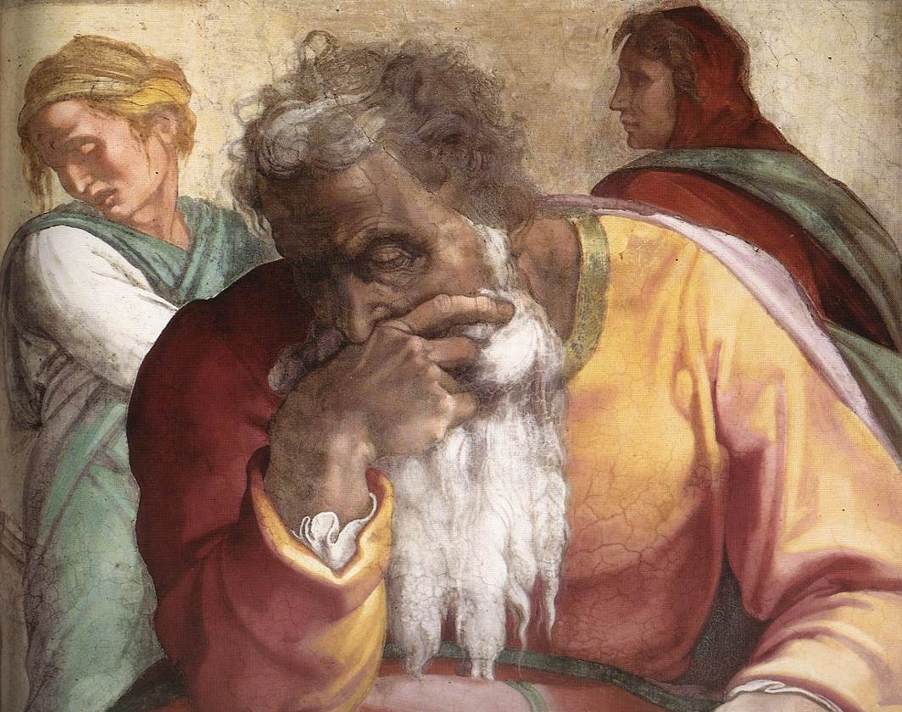
Jeremiah by Michelangelo
diglib.library.Vanderbilt.edu

Slide 6
Matthew 22.29-30 NET, Jesus answered them, “You are deceived, because you don't know the scriptures or the power of God. For in the resurrection they neither marry nor are given in marriage, but are like angels in heaven.”
image from fashionista.com

Slide 7
1 Corinthians 7.7-9 NET: I wish that everyone was as I am. But each has his own gift from God, one this way, another that. To the unmarried and widows I say that it is best for them to remain as I am. But if they do not have self-control, let them get married. For it is better to marry than to burn with sexual desire.
image from fashionista.com

Slide 8
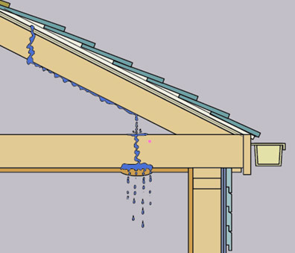
Proverbs 27.15-16 NIV: A quarrelsome wife is like the dripping of a leaky roof in a rainstorm; restraining her is like restraining the wind or grasping oil with the hand.
image from hometips.com

Slide 9
Matthew 19.10-12 NET, The disciples said to him, “If this is the case of a husband with a wife, it is better not to marry!”
He said to them, “Not everyone can accept this statement, except those to whom it has been given. For there are some eunuchs who were that way from birth, and some who were made eunuchs by others, and some who [effectively] became eunuchs for the sake of the kingdom of heaven. The one who is able to accept this should accept it.”

Slide 10
1 Corinthians 7.32-35 NET: An unmarried man is concerned about the things of the Lord, how to please the Lord. But a married man is concerned about the things of the world, how to please his wife, and he is divided.
An unmarried woman or a virgin is concerned about the things of the Lord, to be holy both in body and spirit. But a married woman is concerned about the things of the world, how to please her husband.
I am saying this for your benefit, not to place a limitation on you, but so that without distraction you may give notable and constant service to the Lord.

Slide 11
Loneliness . . .
Celibacy . . .
image from theguardian.com

Slide 12
1. Commitment. Matthew 5.28 NASB: “…everyone who looks at a woman with lust for her has already committed adultery with her in his heart.”
image from theodysseyonline.com

Slide 13
1. Commitment. Matthew 5.28
2. Common Sense. 1 Corinthians 6.18 NIV: Flee from sexual immorality.
image from wiirocku.tumbler.com

Slide 14
1. Commitment. Matthew 5.28
2. Common Sense. 1 Corinthians 6.18
3. Discipline. 1 Corinthians 10.13 NIV: No temptation has overtaken you except what is common to mankind. And God is faithful; he will not let you be tempted beyond what you can bear. But when you are tempted, he will also provide a way out so that you can endure it.
image from wallpapersonthe.net

Slide 15
How the church can help. . .
Include single people in multi-generational fellowships.
Invite single people to social events.
Invite single people to sit with you in church.
Have genuine relationships with single people.

Slide 16
How the church can help. . .
Help single parents.
Don’t make promises not found in scripture.
Don’t hold marriage as the only good outcome.
Be careful what you say or counsel.

Slide 17
Philippians 4.4 NET:
Rejoice in the Lord always. Again I say, rejoice!
image from christianpost.com

Slide 18
Luke 2.36-37 NET: [Anna] was very old, having been married to her husband for seven years until his death. She had lived as a widow since then for eighty-four years. She never left the temple, worshiping with fasting and prayer night and day.
image from christianpost.com

Slide 19
Proverbs 3.5-6 NET: Trust in the LORD with
all your heart, and do not rely on your
own understanding. Acknowledge
him in all your ways, and he will
make your paths
straight.
image from mrperuca cargocollective.com

Slide 20
1 Thessalonians 5.16-18 NET: Always rejoice, constantly pray, in everything give thanks. For this is God's will for you in Christ Jesus.
image from christianpost.com

Slide 21
Proverbs 21.19 NIV: Better to live in a desert than with a quarrelsome and nagging wife.
Proverbs 25.24 NIV:
Better to live on a
corner of the roof
than share a house
with a quarrelsome
wife.
image from zazzle.com

